Slide 2

STATE
OF OPEN SOURCE
.NET
Scott Hanselman
Community Member
@shanselman

Slide 3
.NET Open Source
Timeline

Slide 4

.NET Foundation
.NET Core - Open Sourced
Roslyn
Shared Source “Rotor”
.NET Reference Source
2001
2004
2008
2012
2014
Today
Mono
ASP.NET Open Sourced
TypeScript
.NET Core everywhere
Xamarin OSS
.NET Core RTM June 27th

Slide 5
.NET Today

Slide 6


.NET future innovation
APP MODEL INNOVATION
.NET FRAMEWORK
.NET CORE
XAMARIN
TOOLS
WPF
Windows Forms
UWP
iOS
Android
ASP.NET
ASP.NET Core
OS X
*
Visual Studio
.NET INNOVATION
.NET STANDARD LIBRARY
One library to rule them all
Visual Studio Code
COMMON INFRASTRUCTURE
Xamarin Studio
Compilers
Languages
Runtime components
Notes:
The standard library allows us to innovate much more quickly and those innovations are picked up by all the platforms. Tooling innovation affects both app models & standard library

Slide 7
Blogs from the Community
Here are just a few
Notes:
Interesting Articles for the community

Slide 8
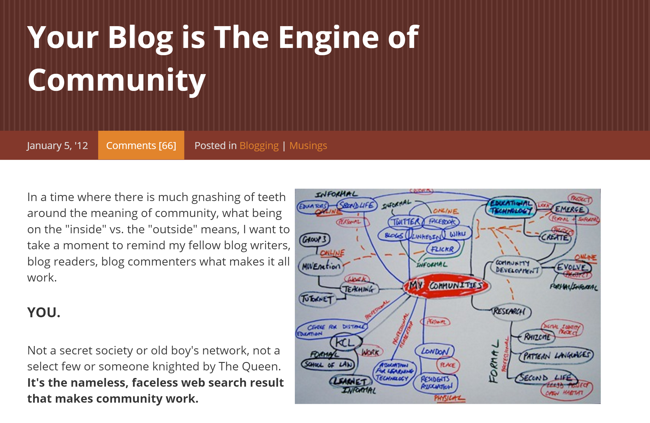
Blogs from the Community
Notes:
Interesting Articles for the community

Slide 9
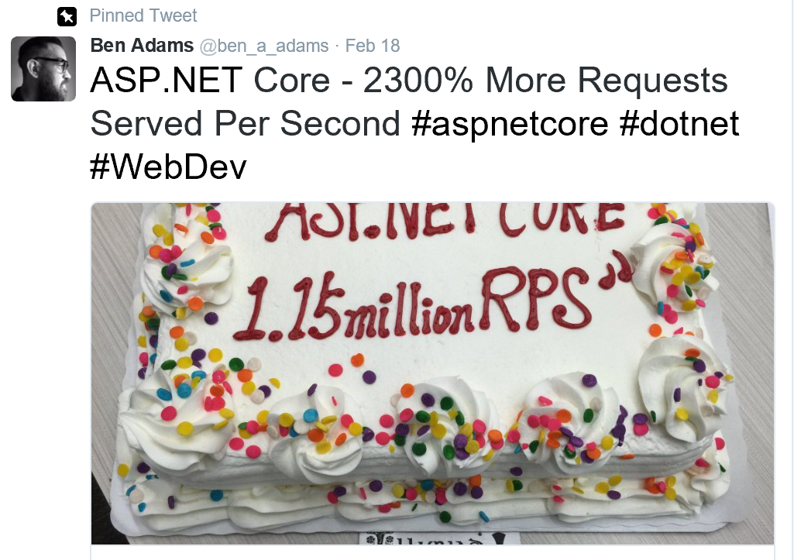
ASP.NET Core 1.15 Million RPS
Ben Adams
web.ageofascent.com
Notes:
We can’t talk about ASP.NET community without calling out Ben Adams. He got inspired watching our weekly ASP.NET Community Standups and started contributing to the ASP.NET server codebase, leading to some huge performance gains!

Slide 10

ASP.NET MVC Boilerplate
Mohammad Rehan Saeed
rehansaeed.com
Notes:
Lots of blog posts or even series are one-offs. Muhammad rolls everything in this series into his (excellent) ASP.NET MVC Boilerplate template. This template lets you check features off on a list, then gives you a pretty full featured starter project covering some more advanced project requirements like accessibility, SEO, social media support, advanced security, etc., leveraging some top open source libraries.

Slide 11
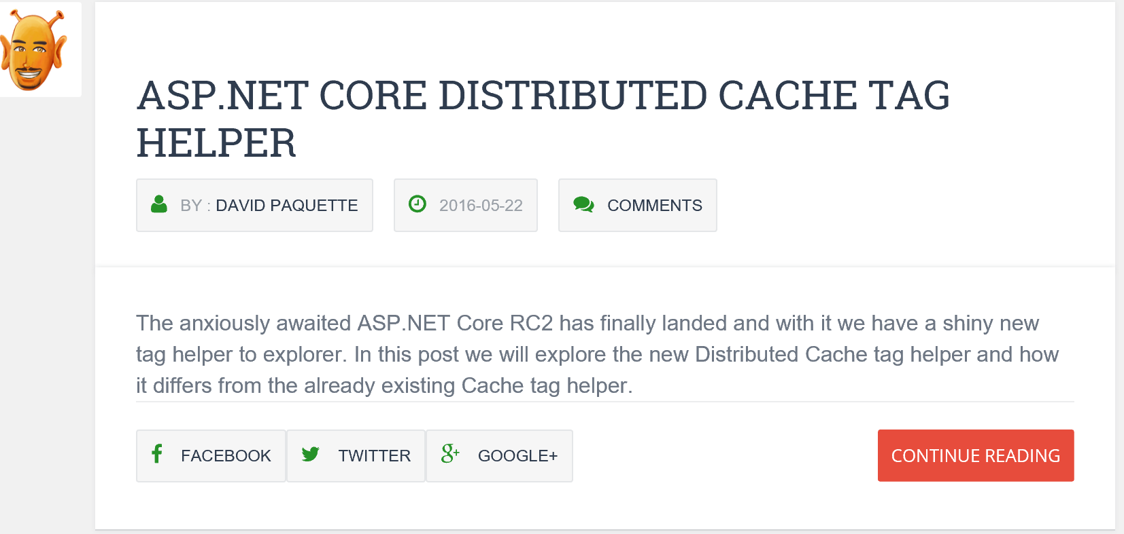
The ASP.NET Monsters
James Chambers, David Paquette, Simon Tibbs
aspnetmonsters.com
Notes:
These three top ASP.NET developers post great content weekly, including video feature screencasts and lots of code.

Slide 12
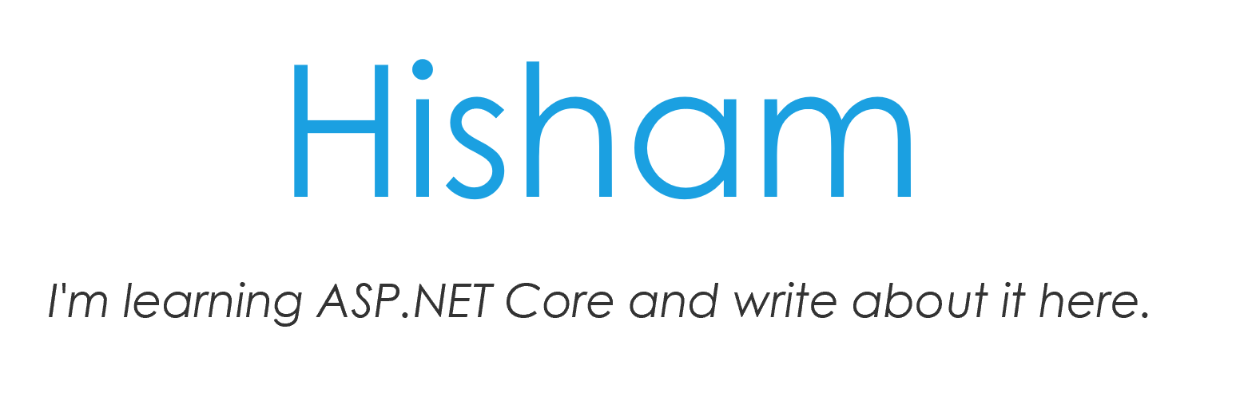
Localization
Hisham Bin Ateya
en.xn--mgbz4cf.com
Notes:
Hisham has been posting a lot of great localization related content for years, including some localization related contributions to ASP.NET. Lots of great content on his blog, including some localization related Tag Helpers lately.

Slide 13



Loads of Code & Custom Graphic
Armen Shimoon
dotnetliberty.com
Notes:
Aremen’s posts are just top quality – lots of custom graphics, thorough coverage, lots of code, and insightful opinions

Slide 14

Entity Framework Core
thedatafarm.com

Slide 15
.NET OSS Growth
How are we doing

Slide 16
.NET 2015

Slide 17
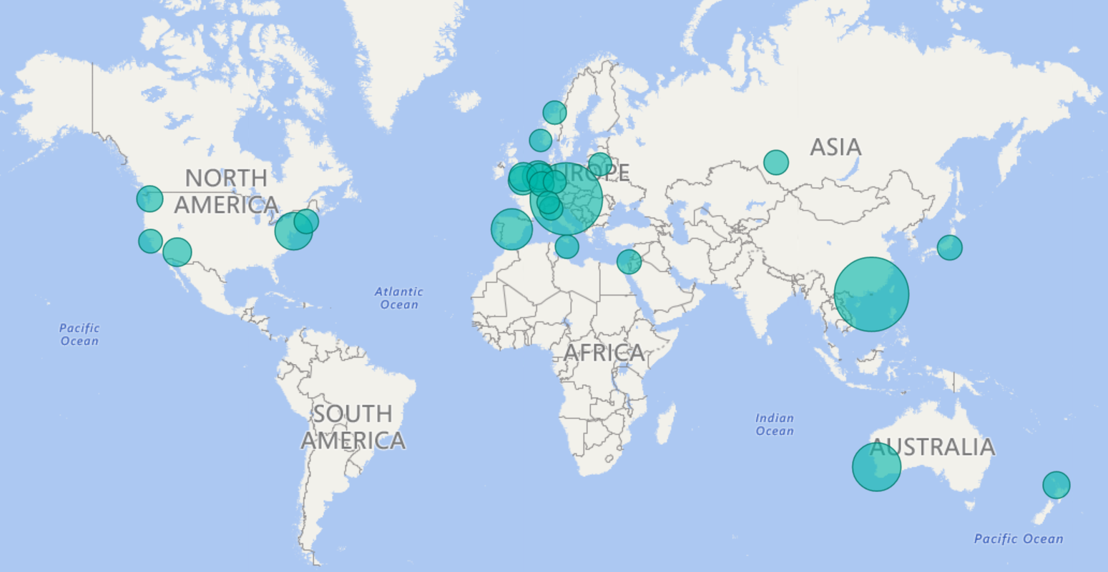
Notes:
Not a link just an image .

Slide 18
.NET 2016

Slide 19
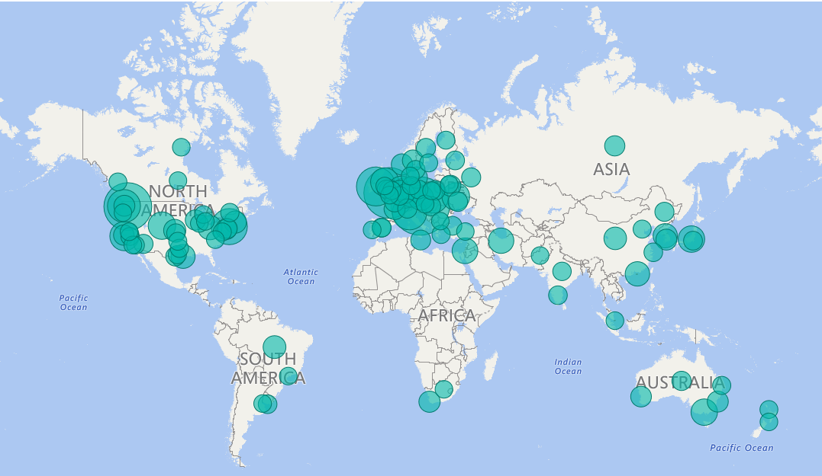

Slide 20
Top 10 PR Requests
ASP.NET, . NET & Xamarin

Slide 21
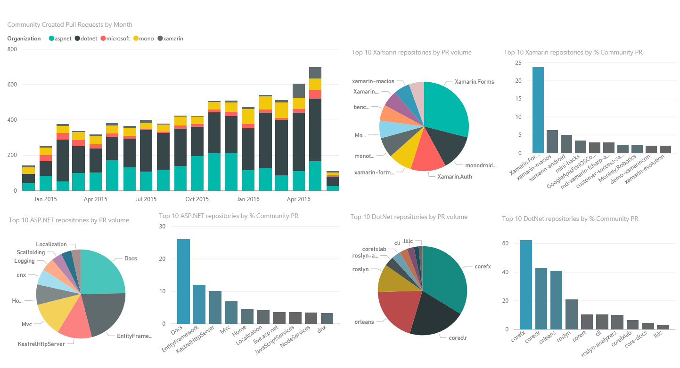
Notes:
Link to livedashboard – Click on Image .
Back up link below
https://msit.powerbi.com/groups/c459fa4e-d04c-420b-b0d1-9dbaa3b8df28/reports/edf0ad6e-0eab-4fab-af90-845f0419367c/ReportSection2

Slide 22
Top Issues Created
Community & Microsoft Created

Slide 23
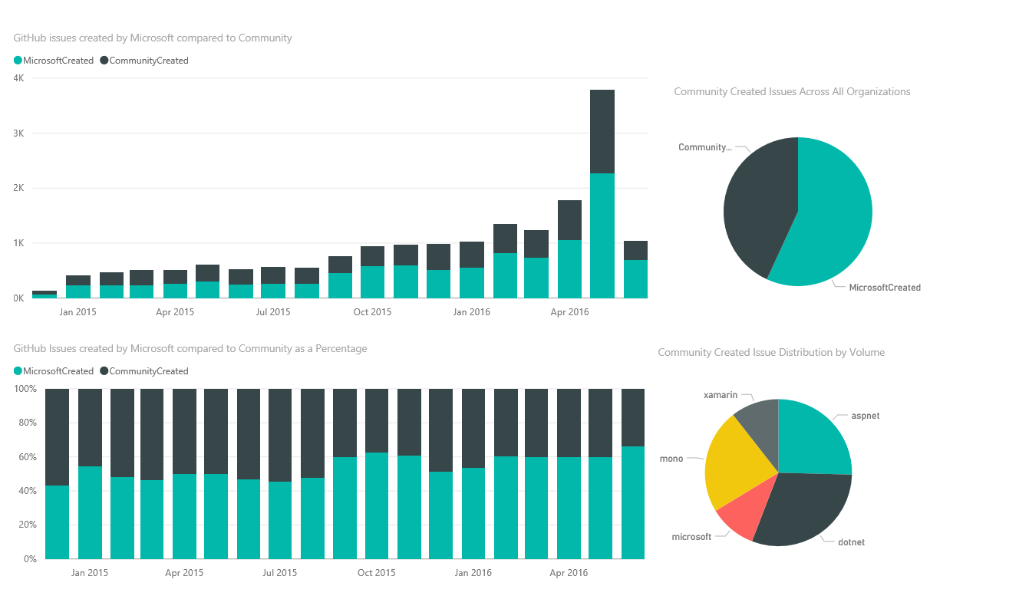

Slide 24
Top Contributors
Awesomeness, GitHubbers , & Companies

Slide 25
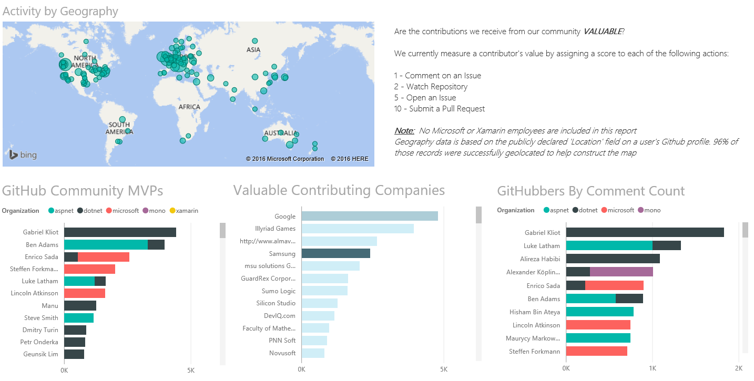
.NET Top Contributors
GitHub Community
Contribution by Company
Comment Count
Notes:
Link to contributor dashboard – Click on any of the Images .
Back up link below
https://msit.powerbi.com/groups/c459fa4e-d04c-420b-b0d1-9dbaa3b8df28/reports/edf0ad6e-0eab-4fab-af90-845f0419367c/ReportSection6

Slide 26
Learning to Code
Bootcamps and Online

Slide 27







What are they learning ?
iOS
Objective C & Swift
Notes:
Bootcamps tend to teach a stack or month or teach you to become proficient in a particular programming language in a couple of weeks. With Ruby, Python, Lamp, JS , android, iOS development being the most popular . With the flexibility of

Slide 28
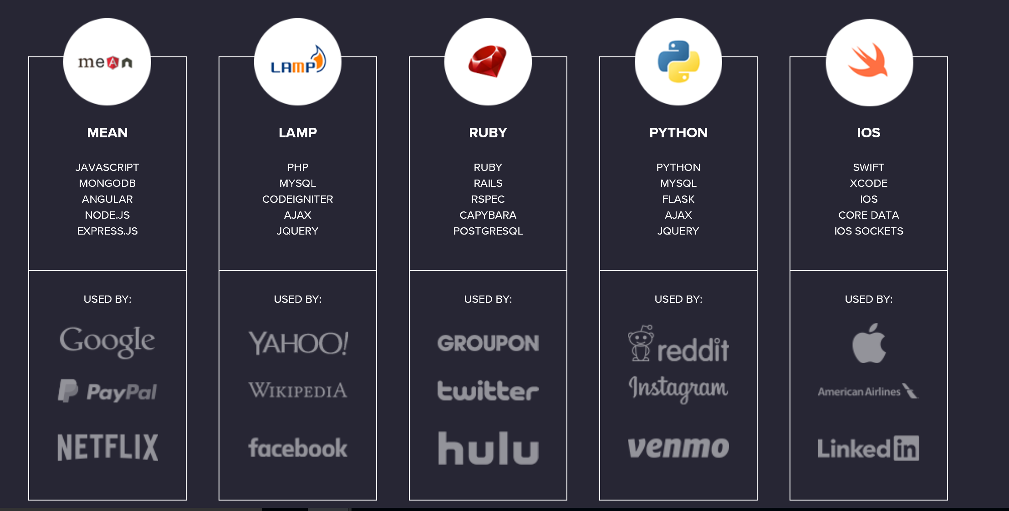
Coding Dojo - We teach FIVE STACKS!
Notes:
Link in the image

Slide 29
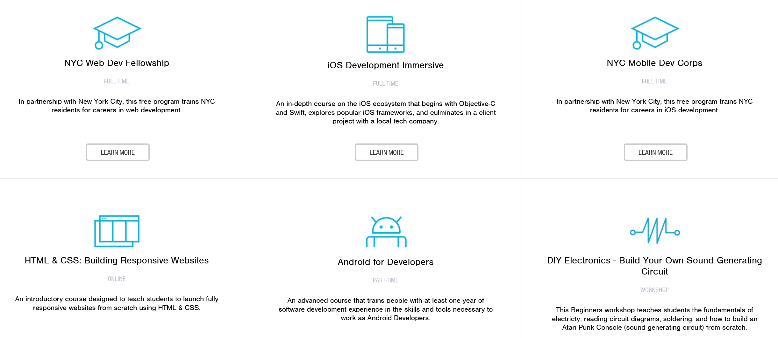
FlatIron School

Slide 30
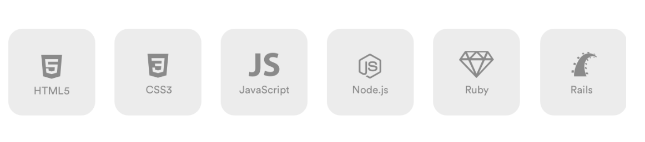
General Assembly

Slide 31
Where’s .NET?

Slide 32

Epicodus
Notes:
Boot Camps teaching to .NET

Slide 33
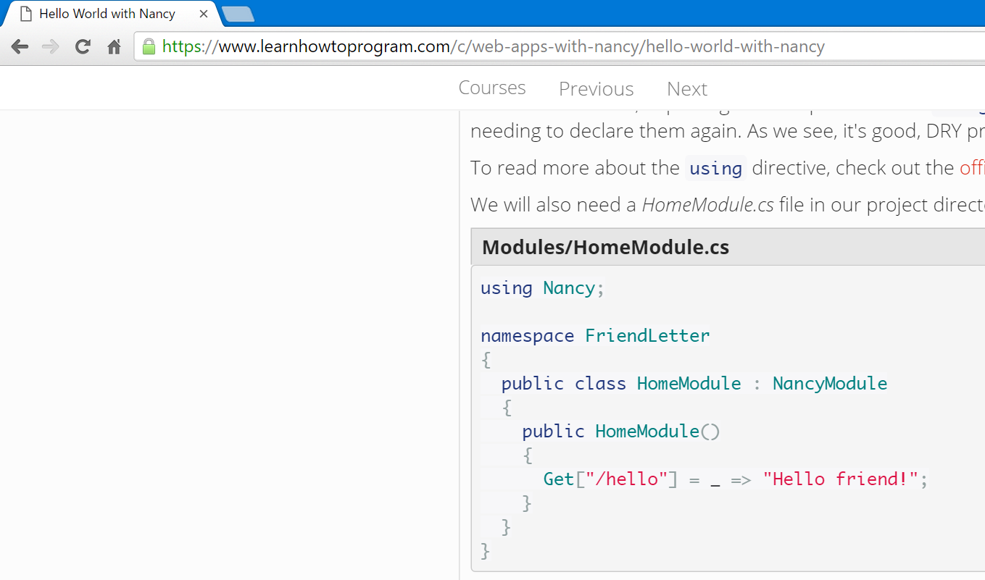

Slide 34
Flexibility Of .NET Core
Creating More Opportunities
Notes:
OSS, Crossplatform

Slide 35


ASP.NET Core 1.0 and the modern web
Totally modular
Faster development cycle
Seamless transition from on-premises to cloud
Choose your editors and tool
Open source with contributions
OSS
Cross-platform
Fast

Slide 36

OSS
More Contributors
Notes:
Let’s Focus on OSS , Cross Platform and text editors

Slide 37
OSS
More Contributors
More Users
Notes:
Let’s Focus on OSS , Cross Platform and text editors

Slide 38
OSS
More Contributors
More Users
More Choices
Notes:
Let’s Focus on OSS , Cross Platform and text editors

Slide 39
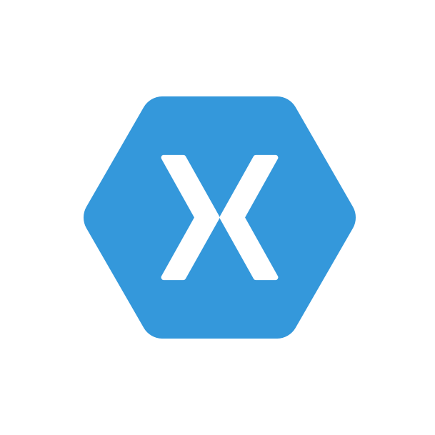



It’s all on GitHub
ASP.NET
Github.com/aspnet
Github.com/dotnet
Github.com/fsharp
Open.xamarin.com
Notes:
Add Xamarin
Note .NET everywhere

Slide 40
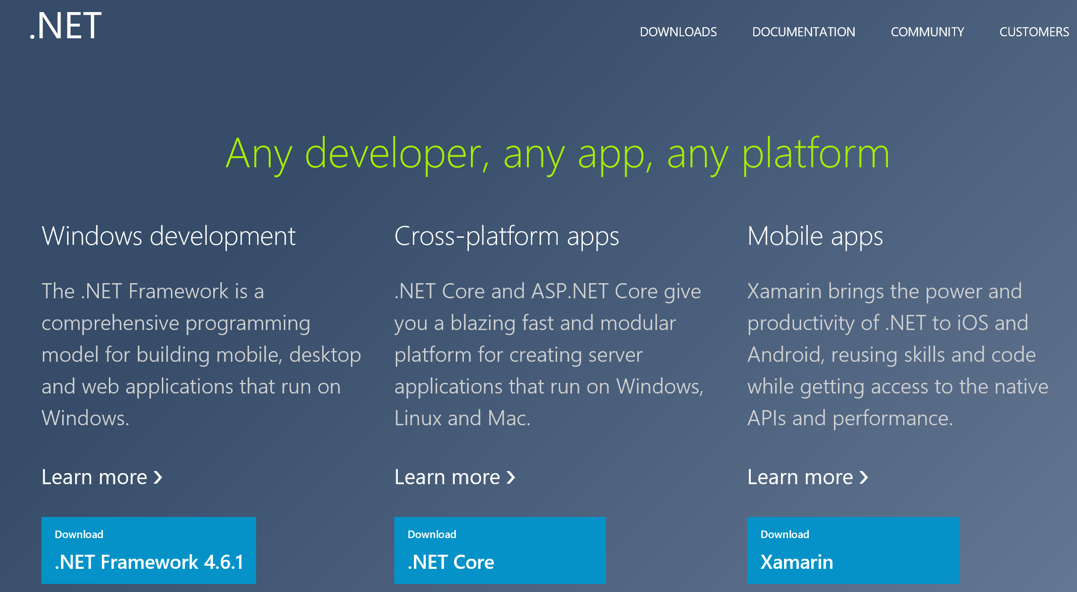
Notes:
Show .dot.net this show that from the homepage on getting started with .NET you are immediately welcome regardless of the

Slide 41
Dotnet Cli Showcase
Pick a platform and showcase the dotnet cli app.
Get started instructions here
https://www.microsoft.com/net/core#windows
Notes:
The dotnet CLI intro - Show the dotnet cli working in docker or windows,

Slide 42
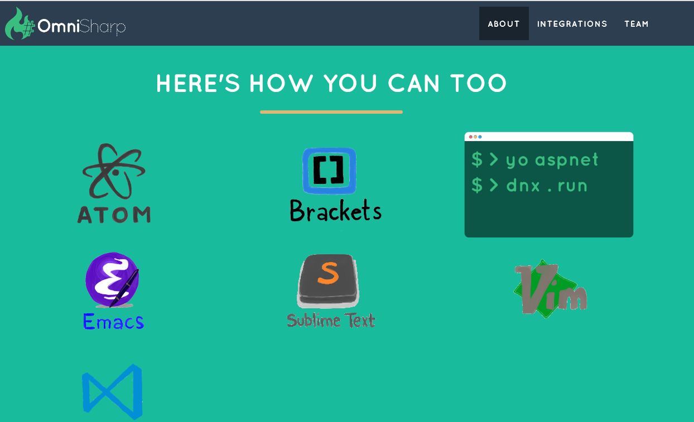
Notes:
Tools used most by Web Developers

Slide 43
Get Involved

Slide 44



.NET Compiler Platform ("Roslyn")
MVVM Light Toolkit
MSBuild
ASP.NET MVC
IdentityManager
ASP.NET Core
MEF
.NET Core
.NET SDK for Hadoop
.NET Micro Framework
Kudu
Cecil
Mimekit
Mono
Mailkit
Xamarin.Auth
Umbraco
Cake
Open Live Writer
NuGet
WorldWide Telescope
Couchbase Lite for .NET
ASP.NET Web Pages
Microsoft Azure SDK for .NET
ASP.NET SignalR
WCF
Openness
Community
Rapid innovation
LLILC
Xamarin SDK
Entity Framework
Open XML SDK
IdentityServer
Microsoft Azure WebJobs SDK
Microsoft Web Protection Library
OWIN Authentication Middleware
Orchard CMS
ProtoBuild
ASP.NET Web API
System.Drawing
Orleans
ASP.NET AJAX Control Toolkit
Prism
Xamarin.Mobile
Salesforce Toolkits for .NET
Protection
Practices
Visibility
Support
Licenses
Copyrights
Trademarks
Patents
Mentorship
Governance
Feedback
Co-ordination
Media
Branding
Events
Hosting
Code signing
CLA Management
Swag
Notes:
Description (“what is the .NET Foundation”)
The .NET Foundation is an independent organization created to foster open development and collaboration around the growing collection of open source technologies for.NET. It will serve as a forum for commercial and community developers alike with a set of practices and processes that strengthen the future of the .NET ecosystem.
Story telling (“why the .NET Foundation”)
Two years ago we announced how some key components of .NET such as ASP.NET MVC or Entity Framework embraced a new development process that was more transparent, open, and community driven. Since then, we have only received great feedback from you. Increasing our investments in .NET, while opening the process to the community has allowed .NET to innovate faster with feedback and contributions. With the .NET Foundation we want to extend this new development model to be the norm for .NET and not the exception. We want to make sure that .NET projects (both from Microsoft and from other companies and individual contributors) have a place that provides the mechanisms to promote the openness, community participation and rapid innovation to build the next generation of the .NET ecosystem.
Messaging pillars (“what are the top three things I need to know about the .NET Foundation”)
It opens the development process for .NET: The .NET Foundation brings into one common umbrella existing and new relevant open source projects for the .NET platform, such as ASP.NET, Entity Framework and the recently added .NET Compiler Platform (“Roslyn”). The .NET Foundation will provide the frame for making this the norm moving forward, so more and more components and libraries of .NET are using an open process that is transparent and welcomes your participation.
It encourages customers, partners and the broader community to participate: The .NET Foundation will foster the involvement and direct code contributions from the community, both through its board members as well as directly from individual developers, through an open and transparent governance model that strengthens the future of .NET.
It promotes innovation by a vibrant partner ecosystem and open source community: The .NET Foundation will promote commercial partners and open source developers to build solutions that leverage the platform openness to provide additional innovation to .NET developers. This includes extending .NET to other platforms, extending Visual Studio to create new experiences, providing additional tools or extending the framework and libraries with new capabilities.
Call to action: Join the conversation
We are just taking the first steps in the creation of the .NET Foundation because we want your feedback and participation from the very beginning. We are starting with a core set of participants including representatives for the .NET open source community, partners and enterprises such as Miguel de Icaza and Salesforce for example, who will collaborate to define the frame of the .NET Foundation. You can actually be part of that process too by providing feedback at dotnetfoundation.org.
LIST OF PROJECTS (25 initially)
.NET API for Hadoop WebClient
http://hadoopsdk.codeplex.com
.NET Compiler Platform ("Roslyn")
http://roslyn.codeplex.com
.NET Map Reduce API for Hadoop
http://hadoopsdk.codeplex.com
.NET Micro Framework
http://netmf.codeplex.com/
ASP.NET MVC
http://aspnetwebstack.codeplex.com/
ASP.NET SignalR
https://github.com/SignalR/SignalR
ASP.NET Web API
http://aspnetwebstack.codeplex.com/
ASP.NET Web Pages
http://aspnetwebstack.codeplex.com/
Composition (MEF2)
http://mef.codeplex.com/
Entity Framework
http://entityframework.codeplex.com/
Linq to Hive
http://hadoopsdk.codeplex.com
MEF (Managed Extensibility Framework)
http://mef.codeplex.com/
OWIN Authentication Middleware
http://katanaproject.codeplex.com/SourceControl/latest#src/Microsoft.Owin.Security.Google/GoogleOAuth2AuthenticationMiddleware.cs
Rx (Reactive Extensions)
https://rx.codeplex.com/
Salesforce Toolkit for .NET
https://github.com/developerforce/Force.com-Toolkit-for-NET
Web Protection Library
http://wpl.codeplex.com/
Windows Azure .NET SDK
https://github.com/WindowsAzure/azure-sdk-for-net
Windows Phone Toolkit
http://phone.codeplex.com/
WnsRecipe
https://github.com/nickharris/WnsRecipe
Xamarin couchbase-lite-net
https://github.com/xamarin/couchbase-lite-net
Xamarin Mailkit
https://github.com/jstedfast/MailKit
Xamarin Mimekit
https://github.com/jstedfast/MimeKit
Xamarin.Auth
https://github.com/xamarin/Xamarin.Auth
Xamarin.Mobile
https://github.com/xamarin/Xamarin.Mobile

Slide 45
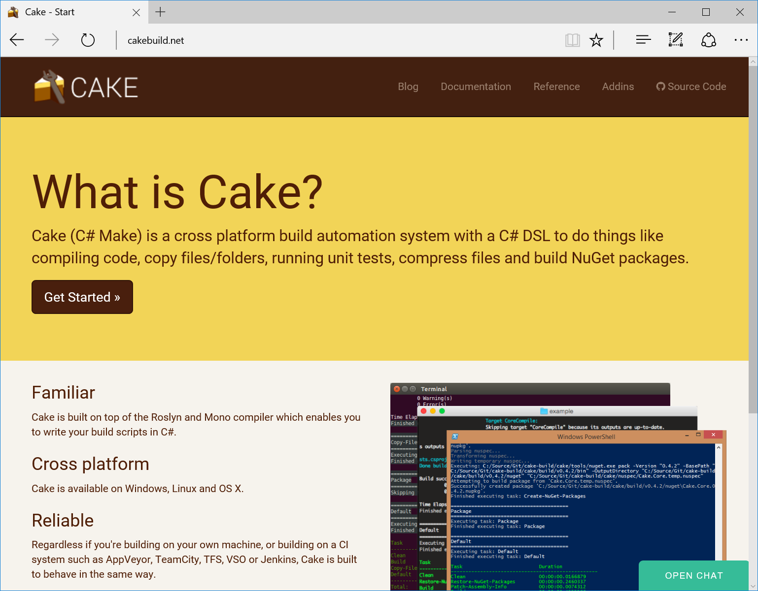
Cake Welcome at the .NET Foundation
Joins .NET Foundation today
C# based x-plat build automation framework
Call out to MSBuild, Test Runners, WiX, Octopus Deploy etc
http://cakebuild.net

